Slide 1




Intro to
presented by Bryan Hunter Firefly Logic
Twitter #erlang
#cfn12
@bryan_hunter
@fireflylogic

Slide 2
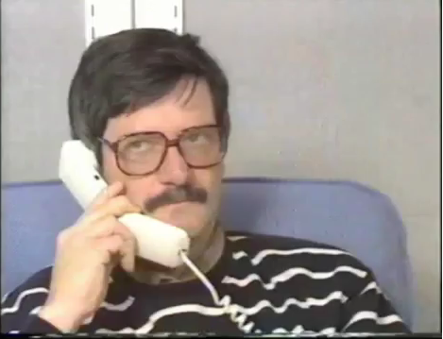
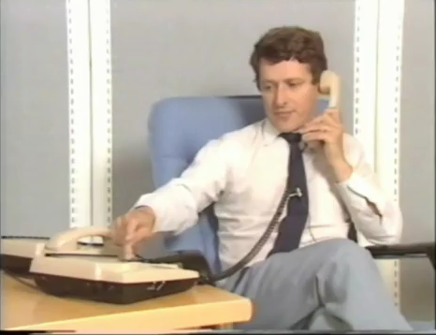
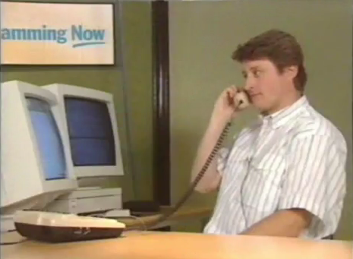
?
Joe
Mike
Any sufficiently complicated concurrent program in another language contains an ad hoc informally-specified bug-ridden slow implementation of half of Erlang.
Robert
(from Erlang the Movie)
Why are we here?

Slide 3
Erlang.
What exactly is Erlang?
Why Erlang?
How do you do it?
Erlang (the language)
+ OTP (libraries, pattern implementations)
+ ERTS (Erlang Runtime System)

Slide 4
Erlang?
What exactly is Erlang?
Why Erlang?
How do you do it?
Erlang is open, proven and cross-platform. It simplifies writing reliable, concurrent, distributed systems. Its pattern matching is FTW.

Slide 5
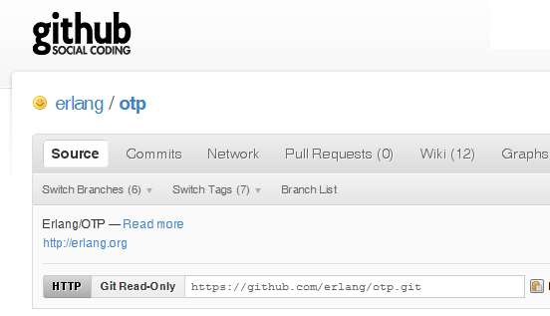
Why -> Erlang is open

Slide 6
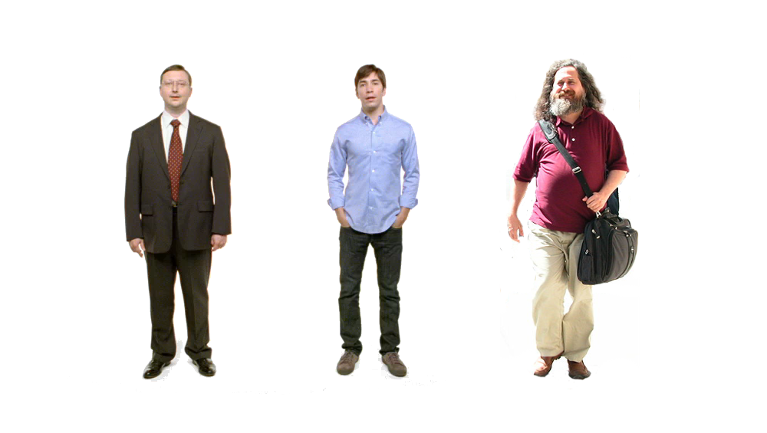
Erlang
Erlang
Erlang
Why -> Erlang is cross-platform

Slide 7













Why -> Erlang is proven

Slide 8
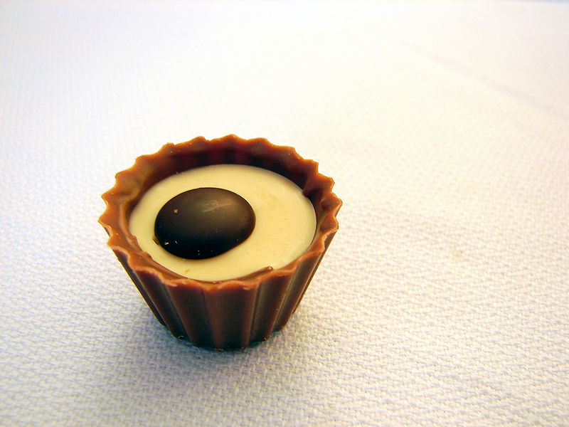
What are the sweet spots?

Slide 9
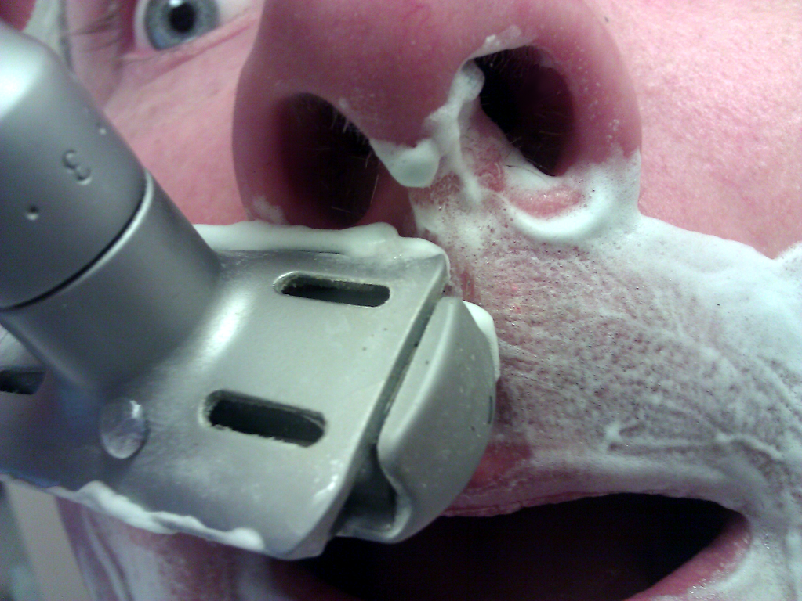
Why -> elsewhere concurrency is painful

Slide 10
One .NET 4.0 Thread (allocates one megabyte)
**********
**********
**********
**********
**********
**********
**********
**********
**********
**********
**********
**********
**********
**********
**********
**********
**********
**********
**********
**********
**********
**********
**********
**********
**********
**********
**********
**********
**********
**********
**********
**********
**********
**********
**********
**********
**********
**********
**********
**********
**********
**********
**********
**********
**********
**********
**********
**********
**********
**********
Heap
Mailbox
Stack
**********
**********
**********
**********
**********
**********
**********
**********
**********
**********
**********
**********
**********
**********
**********
**********
**********
**********
**********
**********
**********
**********
**********
**********
**********
**********
**********
**********
**********
**********
**********
**********
**********
**********
**********
**********
**********
**********
**********
**********
**********
**********
**********
**********
**********
**********
**********
**********
**********
**********
Garbage Collector
Links and Monitors
One Erlang Process (allocates one kilobyte)
*
Why -> elsewhere concurrency is painful

Slide 11
*
*
*
Reductions
- Do 2,000 operations
reduction1 reduction3 .
Reduction2000
- Move to the next guy - Repeat
CPU Core
Why -> elsewhere concurrency is painful

Slide 12
***** *****
***** *****
***** *****
***** *****
Core
Core
Core
Core
Why -> elsewhere concurrency is painful

Slide 13

Why -> distribution was built-in from the start

Slide 14
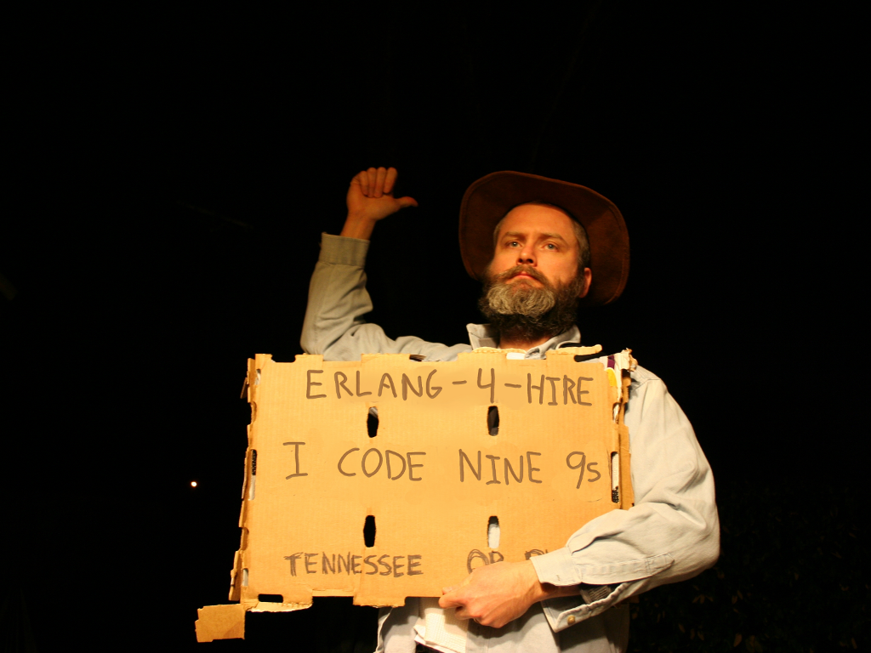
Nines | Uptime | Annual Downtime
9 | 99.9999999% | 30 milliseconds
8 | 99.9999990% | 300 milliseconds
7 | 99.9999900% | 3 seconds
6 | 99.9999000% | 32 seconds
5 | 99.9990000% | 5 minutes
4 | 99.9900000% | 53 minutes
3 | 99.9000000% | 8 hours, 46 minutes
2 | 99.0000000% | 3 days, 15 hours, 36 minutes
Why -> reliability

Slide 15
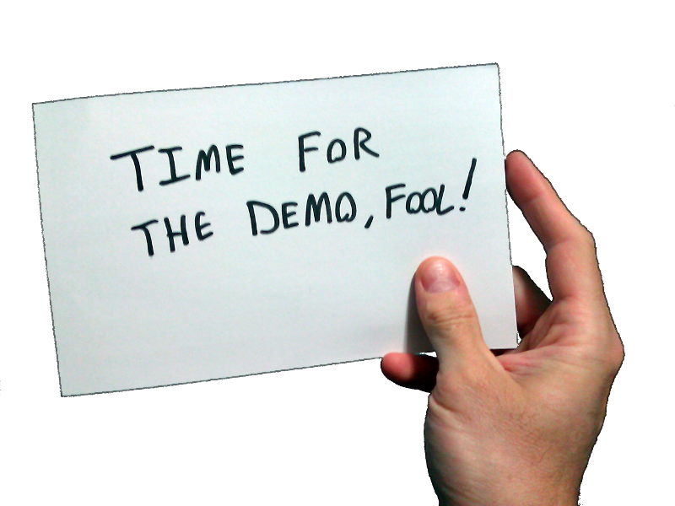
Erlang!
What exactly is Erlang?
Why Erlang?
How do you do it?
In the shell
In a text editor + command line + shell
In Emacs

Slide 16
[insert awe-inspiring demos here]

Slide 17
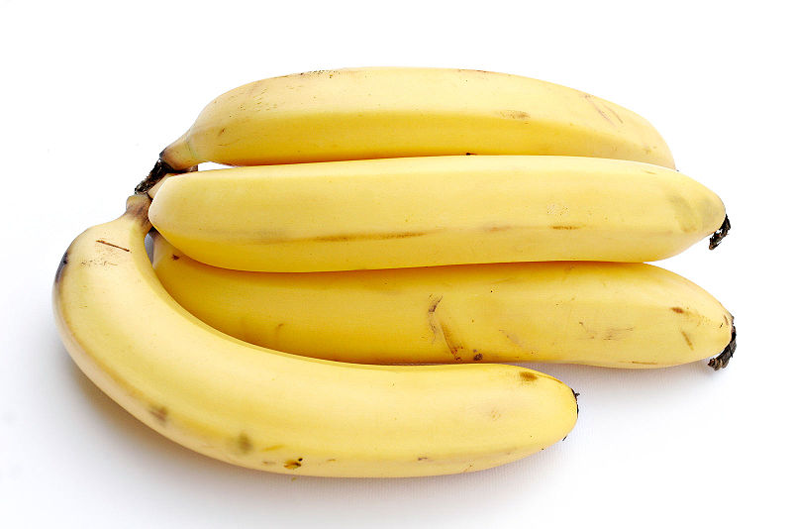

Slide 18
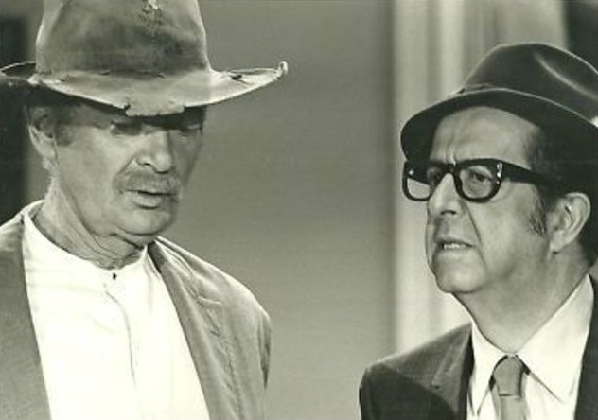
How do you begin to lose your OO accent?
 | C# | Erlang
Filter | ienum.Where(pred) | lists:filter(Fun, List)
Map | ienum.Select(func) enum1.Zip(ienum2, func) | lists:map(Fun, List) lists:zipwith(Fun, List1, List2)
Left Fold | enum.Aggregate(initval, func) | lists:foldl(Fun, Accumulator, List)
Right Fold | enum.Reverse().Aggregate(initval, func) | lists:foldr(Fun, Accumulator, List)

Slide 19
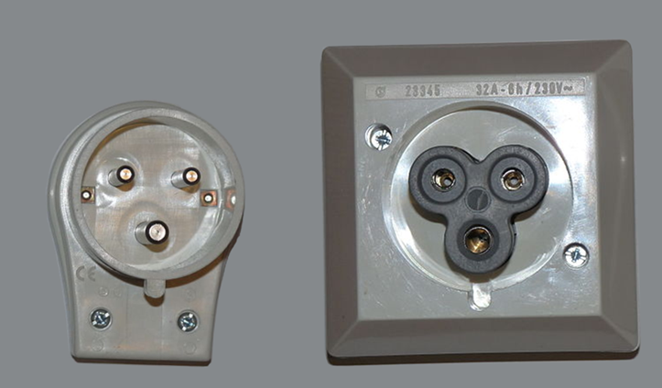
What are the best interop strategies?
You want me to do what!?

Slide 20
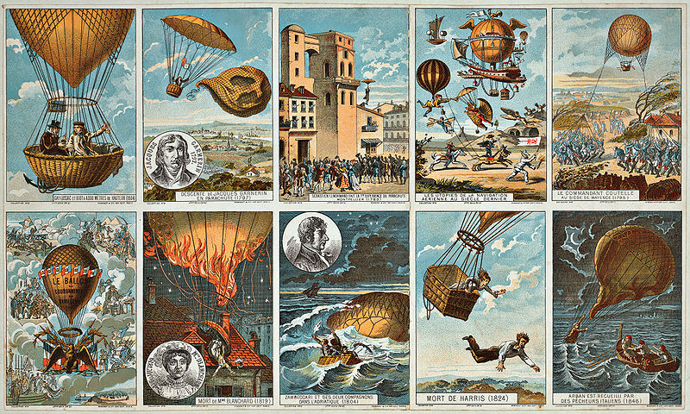
How to pilot Erlang?

Slide 21
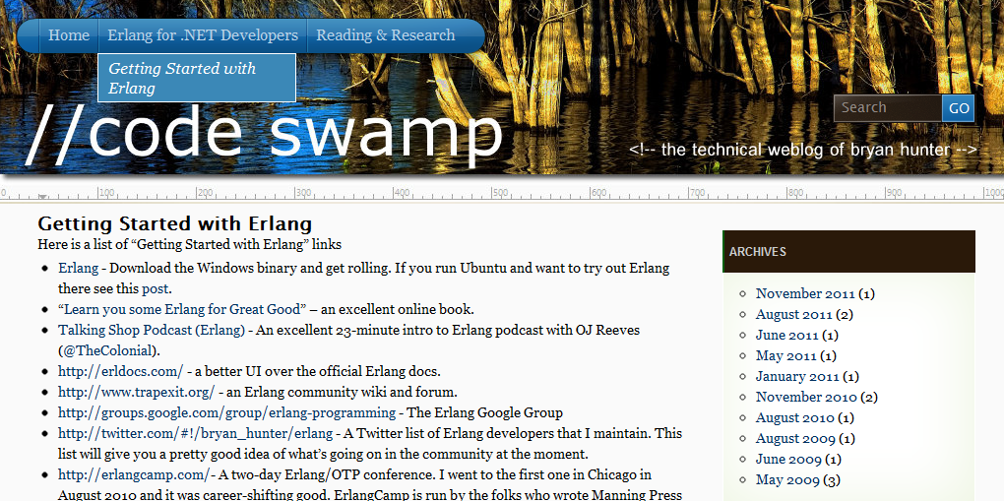
“Getting started” links, script to build Erlang from source on Ubuntu, ongoing screencasts of the Erlang tool-chain,
Info on the book-in-progress “Erlang for .NET Developers”
How -> visit my blog at http://www.codeswamp.com

Slide 22
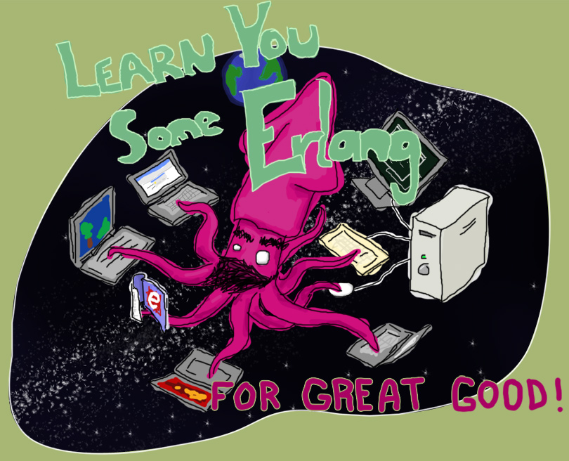
“Learn You Some Erlang for Great Good!” http://learnyousomeerlang.com/
How -> read this excellent and free online book

Slide 23



How -> read some books

Slide 24
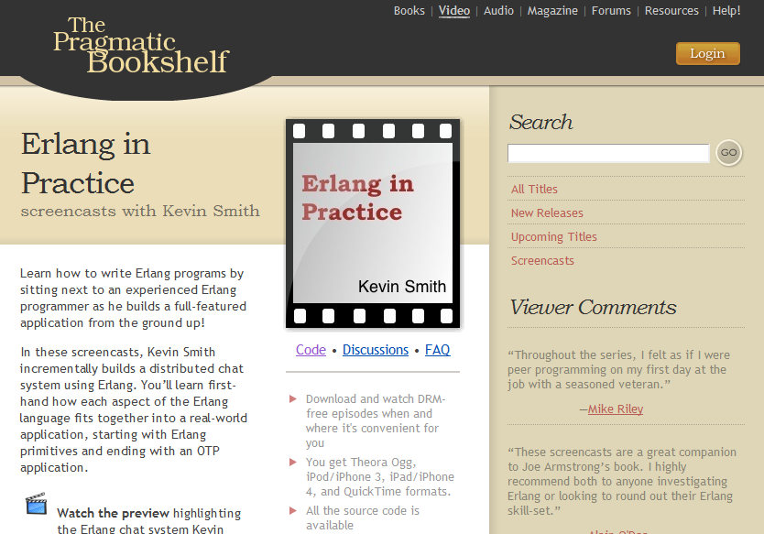
Search “pragmatic kevin smith”
How -> code alongside Kevin Smith for eight screencasts

Slide 25
NashFP Nashville Functional Programmers
http://nashfp.github.com
How -> join your local FP group

Slide 26
Bryan Hunter
Twitter: @bryan_hunter
Email: bryan.hunter@fireflylogic.com
Blog: codeswamp.com
Firefly Logic, Inc.
1000 Main Street, Suite 201 Nashville, TN 37206
http://fireflylogic.com
How -> keep in touch

